Slide 1
Event Overview slide

Slide 2
From Zero to Million: How Amateur Developers and Infrastructure Engineers Built a Million-Dollar App
Chris Sugdinis
Werner Rall

Slide 3

Doubtful Developer Thoughts
Our team consists of infrastructure folks with limited Dev Skills…
I have never written an application for production before…
I am not a Professional Developer…
Is this application the right idea?
“Just Start Writing Code… – Scott Hanselman”
Notes:
- The inception of a simple idea.
- The choice of .NET and PowerShell as their tools of preference.

Slide 4
We will build the Plane as we fly it!
Notes:
- The inception of a simple idea.
- The choice of .NET and PowerShell as their tools of preference.

Slide 5
Agenda
Introduction
Harnessing .NET and PowerShell
Challenges & Breakthroughs
PowerShell in Action
Technical Deep Dive
Lessons Learned & Key Takeaways
Conclusion

Slide 6






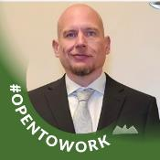



The Team
Photo
Photo
Photo
Photo
Photo
Michael
Schmidt
Werner
Rall
Jon
Ellis
Suhail
Salam
Chris
Sugdinis
Photo
Photo
Photo
Photo
Ken
Wygant
Shawn
Rand
Todd
Sterrett
Nathan
Hughes
Notes:
Welcome & setting the stage.
Introducing the unlikely team of amateur developers and infrastructure engineers.

Slide 7
Team history
This team was and still is one the many internal Cloud Solution Architect Teams at Microsoft that create Customer Deliveries
The primary expertise of the team was Configuration Manager, Intune, Windows, PowerShell, SQL and Power BI.
This project was not part of the engineer’s core duties but more of a stretch job to drive impact.
The Team had previously created a similar Power BI Dashboard for Configuration Manager which was successfully delivered at many customers.
The installer was written in .Net
Notes:
- Developing a robust and scalable application.
- Attracting attention from industry veterans.
- Highlighting the significance of the $1 million revenue mark for Microsoft.

Slide 8
The Opportunity
Typical Customer State | Customer Challenges | Common Customer Objectives
Focused on current patching cycle Fixated on individual update compliance not “total machine compliance” Little to no visibility into compliance for leadership Reporting does not provide historical data | “Out of box” reports don’t provide detailed insight required by enterprise customers Few solutions provide overall compliancy Required updates are missed Gaps in automatic update rules | Improve security to meet industry compliance (PCI, healthcare, government) Reduce effort to monitor security vulnerabilities Maintain high security compliance over time Simplify Security Vulnerabilities compliance tracking Reduce the costs & resources associated with managing infrastructure Eliminate unneeded update and machine data
Notes:
- Developing a robust and scalable application.
- Attracting attention from industry veterans.
- Highlighting the significance of the $1 million revenue mark for Microsoft.

Slide 9
Microsoft Graph Security API’s
Microsoft Defender for Endpoint API
Built-in. Cloud-powered.
THREAT & VULNERABILITY MANAGEMENT
ATTACK SURFACE REDUCTION
NEXT GENERATION PROTECTION
ENDPOINT DETECTION & RESPONSE
AUTO INVESTIGATION & REMEDIATION
MICROSOFT THREAT EXPERTS
Improve OS Security Baseline & Hygiene. Actionable insights & remediation workflows
Defensive Layer – Host Intrusion Prevention, Next-Gen Antivirus, Network/ Web/ Exploit Protection, Network Firewall
Deep Visibility, Hunting, Post-Breach Investigation, Response & Remediation
Microsoft Human experts watching & alerting 24/7
CENTRALIZED CONFIGURATION AND ADMINISTRATION
Notes:
- Developing a robust and scalable application.
- Attracting attention from industry veterans.
- Highlighting the significance of the $1 million revenue mark for Microsoft.
Less Important Slide – Could be hidden or dropped

Slide 10
Harnessing .NET
Easiest way to wrap our code while leaving room for improvement in the future
The previous installer was written in .Net
Familiar editor being Visual Studio 2019 & 2022
Free time in December
Notes:
- Developing a robust and scalable application.
- Attracting attention from industry veterans.
- Highlighting the significance of the $1 million revenue mark for Microsoft.

Slide 11

Challenges & Breakthroughs
We had to write code in different time zones
Learn how to wrap PowerShell in C#
Learn how to incorporate different views of how scripts, tools and processes should work
Many, many, many builds and tests
Building and flying the plane in production with Customers
Notes:
- Discussing the hurdles faced during the development process.
- Key moments of inspiration and innovation.
- Practical solutions to technical challenges.

Slide 12
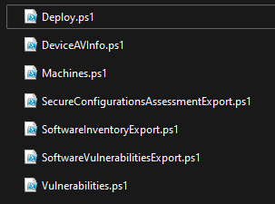
PowerShell in Action
We chose PowerShell because most team members can quickly read and understand PowerShell
PowerShell is easily used to build resources in Azure when providing a JSON ARM Template
We needed PowerShell in the Azure Automation Account
Notes:
- Introduction to PowerShell's role in the project.
- Automating the creation and management of Azure resources.
- Enhancing the team's ability to rapidly iterate and scale.

Slide 13
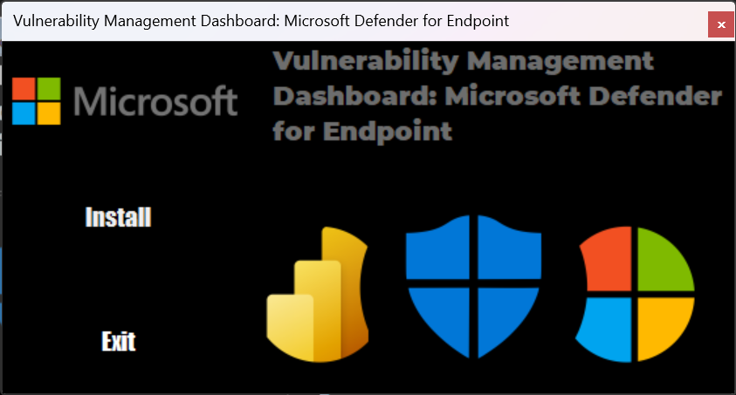
The Installer
Notes:
Update Name

Slide 14

Demo 1: Visual Studio
Notes:
- Delving into the technical details of the app development process.
- Showcasing important code snippets and architectural decisions.

Slide 15
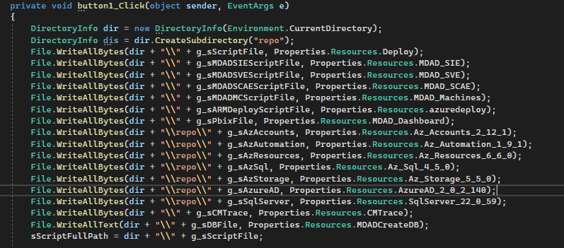
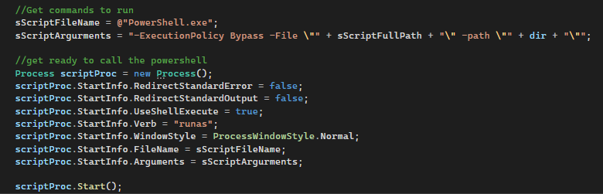
Code sample: Wrap PowerShell Script

Slide 16
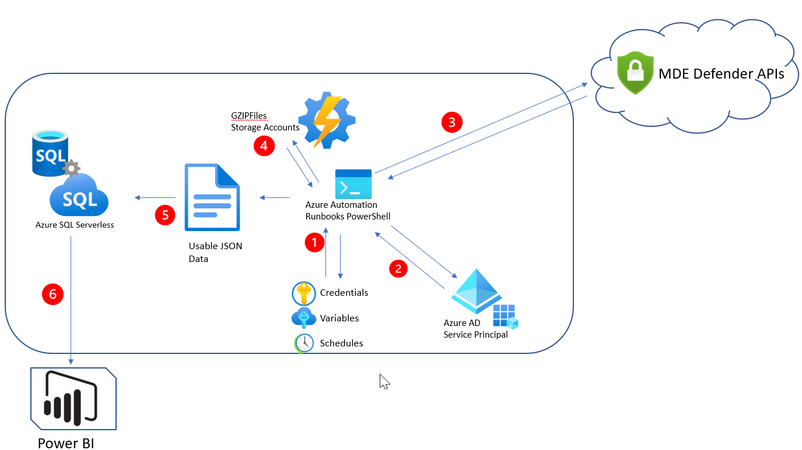
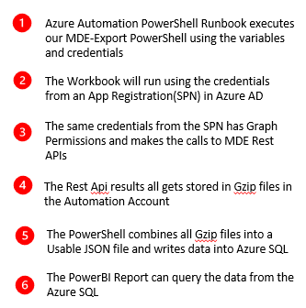
The Architecture in Azure
Overview
Notes:
- Developing a robust and scalable application.
- Attracting attention from industry veterans.
- Highlighting the significance of the $1 million revenue mark for Microsoft.

Slide 17
Demo 2: The Installer
Notes:
- Delving into the technical details of the app development process.
- Showcasing important code snippets and architectural decisions.

Slide 18
Remember our plane?
What? MDE is evolving! (Customers are liking this app and providing great feedback. It’s getting better!)
MDE evolved into a high demand solution for customers!
Notes:
- Reflecting on the journey and its implications.
- Guiding principles and best practices the team discovered.

Slide 19
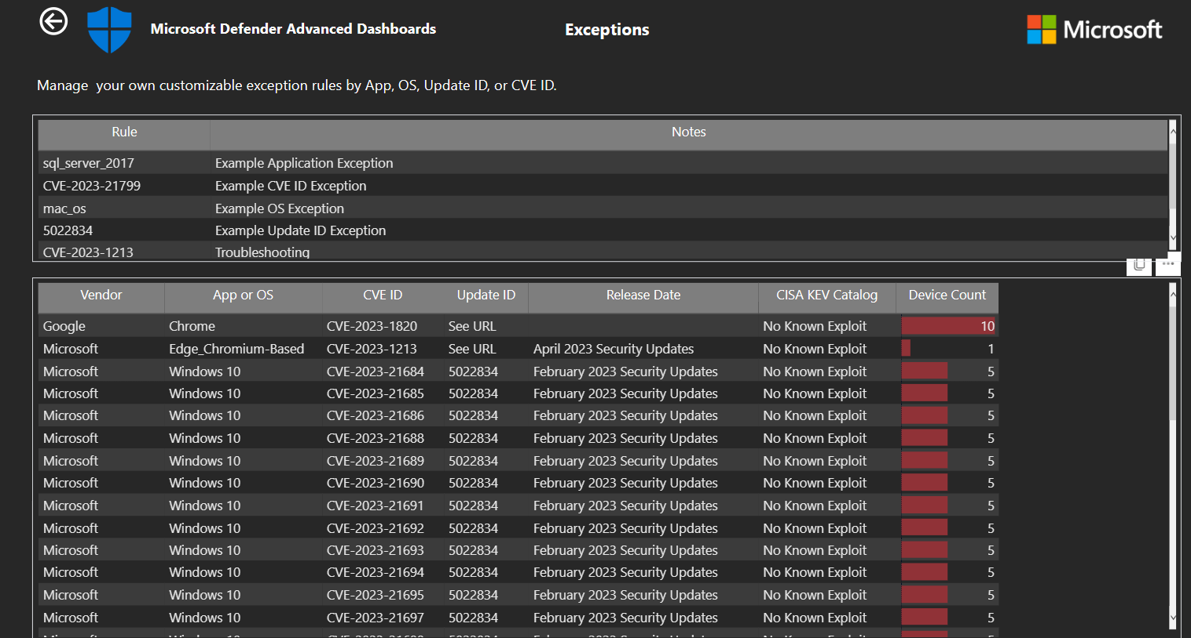
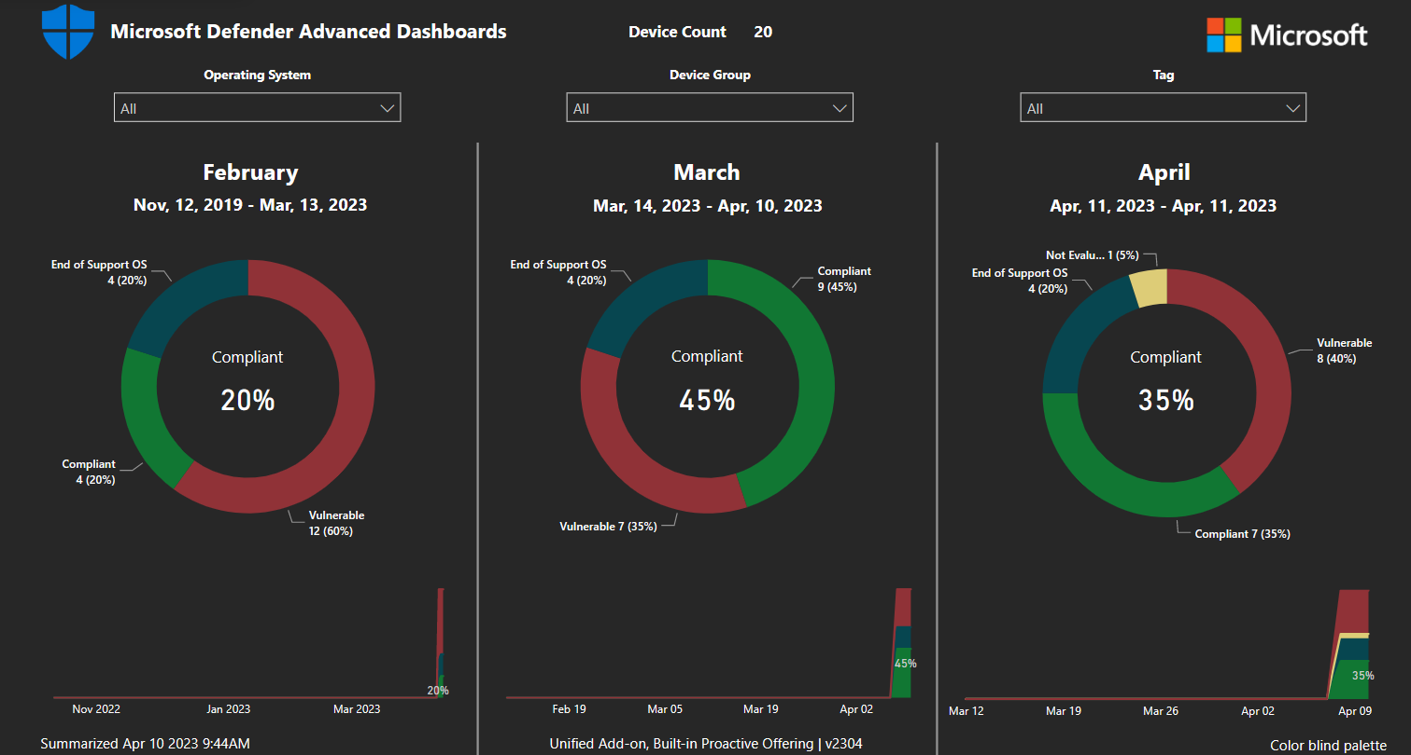
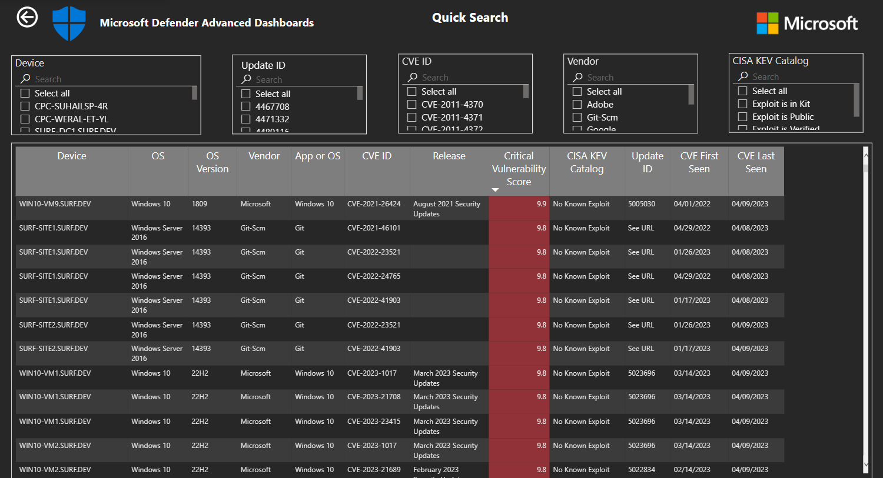
The Power BI Dashboard

Slide 20
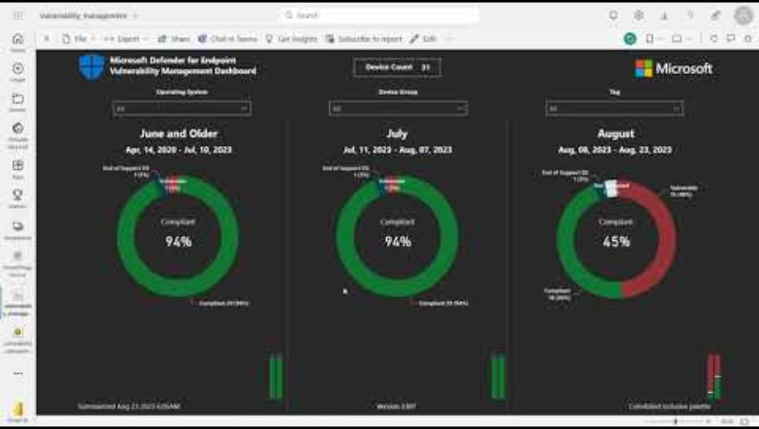
Demo 3: The Power BI Dashboard
Notes:
- Delving into the technical details of the app development process.
- Showcasing important code snippets and architectural decisions.

Slide 21
Lessons Learned & Key Takeaways
Marketing is important! We used a blog, internal videos, word of mouth, sponsors, managers, demos, showcases
Reporting: You cannot improve what you do not measure
Ease-of-use: The best technology for you may not be the best technology for your team
Don’t be afraid to try new things (That idea you have never worked on)
Fail hard and Fail Fast BUT failing does not make you a failure, it’s part of the game.
Notes:
- Reflecting on the journey and its implications.
- Guiding principles and best practices the team discovered.

Slide 22


Not-yet-a-developer Timeline
While attending college, wrote my first Application
Joined Microsoft
Let’s try creating an app again
Upon Joining Microsoft, I realized in our South African Offices it was difficult to book meeting rooms. Created a Desktop Application that will book meeting rooms using Outlook. Visual Studio 2019. This app worked and a few people actually used it!
I remember creating my very first Form Ever using Visual Studio 2009. None of the logic worked and I failed the class.
Manager asked if anybody could write applications and I said yes (should have said no). Tried to write an application that could help with Neighborhood watch. Never finished. Visual Studio 2015, but I learned a lot.
2010
2013
2015
2016
2019
2022
PowerShell
After learning about batch files and PowerShell I created a computer performance tracking application that displayed an HTML report that was used by all Desktop Support Teams
MDAD Application
SCOM Bing Maps
. Net 6.0 Desktop application using PowerShell Modules to create Azure Resources in Visual Studio 2022.
Delivering this to Customers and generated
Wrote a desktop application that uses computer attributes out of Active Directory to retrieve locations and places them on Bing maps. I tried also to tie in the server health data because On-Prem servers would always be unpredictable. Visual Studio 2015. Also wrote 25 Demo Websites.

Slide 23

What about the money?
Total Deliveries Created (Y1) : 69
First Year Revenue: > $1,000,000
2013
2015
2016
2019
2022

Slide 24
Start building your plane Today!
You do not have to be a Professional Developer to achieve your application goals
Sometimes success takes work. But it’s fun work because you are working on your own future. If it isn’t fun, try something else.
You will never waste money on education. Just because you don’t use new skills immediately doesn’t make them irrelevant.
With dedication, the right tools, and team collaboration, even amateurs can achieve greatness!
Notes:
- Emphasizing the possibilities of .NET, PowerShell, and Azure.
- The message: With dedication, the right tools, and team collaboration, even amateurs can achieve greatness.

Slide 25

Resources
Download .NET 8 aka.ms/get-dotnet-8
Vulnerability Management Dashboard: Microsoft Defender for Endpoint https://techcommunity.microsoft.com/t5/core-infrastructure-and-security/customer-offerings-security-microsoft-defender-advanced/ba-p/3719775

Slide 26
Thank you and don’t forget to Download .NET 8
https://aka.ms/get-dotnet-8

